Slide 1

Knock Knock Knock
By: Jadie Ashcraft

Slide 2
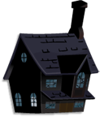
There's a house on my block If you walk past you’ll hear a “knock, knock, knock” If you walk past you’ll feel a bitter chill
You’ll feel spinely fingers and hear a whisper in your ear The old house will give you a dreadful scare Then you would wonder, “Who is there?”
If you walk past you’ll hear a clatter of bones. If you walk past you’ll hear falling stones. That’s not all, but I’m warning you If you walk past you’ll hear a black crow too.

